Slide 1
Chapter 2: Common Controls in WPF

Slide 2
Learning Objectives
Button
Labels
Text Boxes
Panels and containers
Check boxes and radio buttons
Menus and toolbars
Navigation

Slide 3
WPF Common Controls
Button: A Button control reacts to user input from a mouse, keyboard, stylus, or other input device and raises a Click event.
A Button is a basic user interface (UI) component that can contain simple content, such as text, and can also contain complex content, such as images and Panel controls.
Label: controls usually provide information in the user interface (UI).
Historically, a Label has contained only text, but because the Label that ships with Windows Presentation Foundation (WPF) is a ContentControl, it can contain either text or a UIElement.
TextBox: The TextBox class enables you to display or edit unformatted text. A common use of a TextBox is editing unformatted text in a form.
Panel: Panel elements are components that control the rendering of elements—their size and dimensions, their position, and the arrangement of their child content.
The Windows Presentation Foundation (WPF) provides a number of predefined Panel elements as well as the ability to construct custom Panel elements.
The WPF includes a comprehensive suite of derived panel implementations that enable many complex layouts.
These derived classes expose properties and methods that enable most standard user interface (UI) scenarios.
Next slide provides a list of Panel elements that provide specialized behavior for containers.

Slide 4
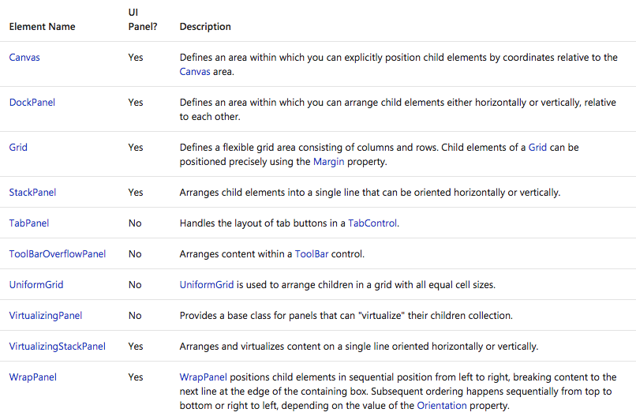
WPF Common Controls

Slide 5
WPF Common Controls
CheckBox: You can use a CheckBox in the user interface (UI) of your application to represent options that a user can select or clear. You can use a single check box or you can group two or more check boxes.
RadioButton: controls are usually grouped together to offer users a single choice among several options; only one button at a time can be selected.
ComboBox: The ComboBox control presents users with a list of options. The list is shown and hidden as the control expands and collapses.
In its default state, the list is collapsed, displaying only one choice. The user clicks a button to see the complete list of options.
DatePicker: The DatePicker control allows the user to select a date by either typing it into a text field or by using a drop-down Calendar control.
Document Viewer: The DocumentViewer control is used to view FixedDocument content (such as XML Paper Specification (XPS) documents) in a paginated format.
GridSplitter: The GridSplitter redistributes space between columns or rows of a Grid control.
GroupBox: control is a HeaderedContentControl that provides a titled container for graphical user interface (GUI) content.
Image: element is used to display bitmap images in Windows Presentation Foundation (WPF) applications.

Slide 6
WPF Common Controls
ListBox: control provides users with a list of selectable items.
ListView: control provides the infrastructure to display a set of data items in different layouts or views.
Menu: is a control that allows hierarchical organization of elements associated with commands or event handlers.
Each Menu can contain multiple MenuItem controls.
Each MenuItem can invoke a command or invoke a Click event handler.
A MenuItem can also have multiple MenuItem elements as children, forming a submenu.
Popup: control displays content in a separate window that floats over the current application window.
ProgressBar: indicates the progress of an operation. The ProgressBar control consists of a window that is filled with the system highlight color as an operation progresses.
RichTextBox: element defines an editing control with built-in support for features such as cut and paste, rich document presentation, and content selection.
ScrollBar: allows you to view content that is outside of the current viewing area by sliding the Thumb to make the content visible.
Slider: allows you select from a range of values by moving a Thumb along a Track.
StatusBar: is a horizontal area at the bottom of a window where an application can display status information.

Slide 7
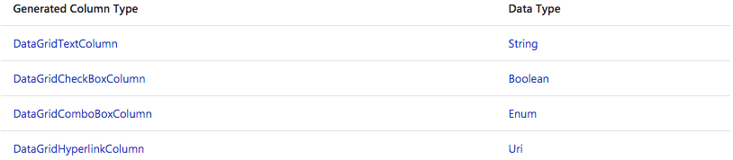
WPF Common Controls
TextBlock: control provides flexible text support for WPF applications. The element is targeted primarily toward basic UI scenarios that do not require more than one paragraph of text.
ToolBar: control is a container for a group of commands or controls that are typically related in their function.
DataGrid: control enables you to display and edit data from many different sources, such as from a SQL database, LINQ query, or any other bindable data source.
Columns can display text, controls, such as a ComboBox, or any other WPF content, such as images, buttons, or any content contained in a template.
You can use a DataGridTemplateColumn to display data defined in a template.
The following table lists the column types that are provided by default.

Slide 8
WPF Navigation
Windows Presentation Foundation (WPF) supports browser-style navigation that can be used in two types of applications: standalone applications and XAML browser applications (XBAPs).
To package content for navigation, WPF provides the Page class. You can navigate from one Page to another declaratively, by using a Hyperlink, or programmatically, by using the NavigationService.
WPF uses the journal to remember pages that have been navigated from and to navigate back to them.Page, Hyperlink, NavigationService, and the journal form the core of the navigation support offered by WPF.
In WPF, you can navigate to several content types that include .NET Framework objects, custom objects, enumeration values, user controls, XAML files, and HTML files.
However, you'll find that the most common and convenient way to package content is by using Page.
Furthermore, Page implements navigation-specific features to enhance their appearance and simplify development.

Slide 9
WPF Navigation
To allow a markup file and code-behind file to work together, the following configuration is required:
In markup, the Page element must include the x:Class attribute.
When the application is built, the existence of x:Class in the markup file causes Microsoft build engine (MSBuild) to create a partial class that derives from Page and has the name that is specified by the x:Class attribute.
This requires the addition of an XML namespace declaration for the XAML schema ( xmlns:x="http://schemas.microsoft.com/winfx/2006/xaml" ).
The generated partial class implements InitializeComponent, which is called to register the events and set the properties that are implemented in markup.
In code-behind, the class must be a partial class with the same name that is specified by the x:Class attribute in markup, and it must derive from Page.
This allows the code-behind file to be associated with the partial class that is generated for the markup file when the application is built (see Building a WPF Application).
In code-behind, the Page class must implement a constructor that calls the InitializeComponent method. InitializeComponent is implemented by the markup file's generated partial class to register events and set properties that are defined in markup.

Slide 10
How-To Examples
We will look at the following practical examples of WPF topics covered:
Using Common Controls to build a simple survey.
User registration wizard using Navigation.

Slide 11
What are we learning in Next Chapter ?
You will learn about Working with Data in WPF
We will learn about:
Data binding
Data controls
Data providers

Slide 12
Thank You !

